Slide 1


MGMT 590 - Web Data Analytics -
Group 6

Slide 2





Team
Sanjana
Santhanakrishnan
Sudipta
Singh
Surya Sathiyamurthy
Aditya
Gupta

Slide 3




Executive Summary
Case Analysis
Recommendations and Limitations
Agenda
Introduction and Problem Statement

Slide 4

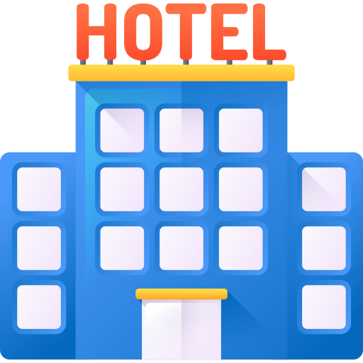

Current Problems faced by Hotels
Impact of COVID on tourism, especially hotels – The impact of COVID on the travel industry has been significant, with many hotels and restaurants closing down in these tough times without proper business
Misleading Information – People and Hotels both get lost looking for their perfect hotels and guests respectively; TripAdvisor bridges this gap to an extent, so it is important for hotels to rank better in their website in order to get more visibility and in turn more business

Slide 5

Business Problem
Need for Information - A new hotel coming up needs information on which location to choose, what kind of amenities to have and how to leverage these for a better performance
Customer Perception – New or underperforming hotels need data on which kind of customers to cater to and expand their business into. They also require information on which customers are least satisfied with their current hotel choices and are looking for new options.

Slide 6





Hotel Profile
Hotels with the following Features
Hotels in California
$210.75
Average price of Hotels
Hotels having COVID safety section
4.35
Average Rating of hotels
73
Average Walking Score^
Hotels having their own website
550
Average # of Reviews
Hotels running offers
262
Average # of pictures for each hotel
% of Hotels
^ Walk Score is dependent on the # of nearby places like restaurants, attractions that are surrounding the hotel

Slide 7
Review Profile
Trip Type of Reviewers
Reviews from California
10
Reviews for top 10 Hotels
4.48
Average Rating of Reviewers
% of Reviews
% of Reviews
24905
Total # of Reviews

Slide 8
Executive Summary
Case Analysis
Recommendations and Limitations
Agenda
Introduction and Problem Statement

Slide 9

Executive Summary
Overview – Help new hotels and underperforming hotels to improve their ranking
Problem – Impact of COVID, lack of proper information and improvement of customer perception
Recommendations –
Information - Having COVID sections and proper descriptions as well as having non-smoking rooms in hotels
Location of a hotel near restaurants rather than tourist attractions
People - Focusing on travelers from other location, especially business travelers

Slide 10
Executive Summary
Case Analysis
Recommendations and Limitations
Agenda
Introduction and Problem Statement

Slide 11

Factors Affecting Ranking
# of Attractions
Overall Rating
# of Restaurants
# of Reviews
Hotels
COVID Safety
Location Rating
Description of Hotel
Room Type
(Non – Smoking)

Slide 12

Effect of COVID Section on Hotel Rankings
Hotels that have COVID safety section have a significantly higher ranking than hotels that do NOT have COVID section
It is recommended for the new or existing hotels to have the COVID safety measures implemented and have it listed on their Tripadvisor page
Hotels with COVID section
S
Hotels without COVID section
Average Rank of Hotels
S
Statistically significant difference (with 95% CL)
Test performed: T- Test

Slide 13

Effect of Non-Smoking Room on Hotel Rating
With the ongoing COVID-19 pandemic, more and more people are preferring hotels with Non-Smoking rooms and this translates into a significantly higher rating of hotels that have non-smoking rooms compared to others
It is recommended for the hotels to have or convert some of their rooms to Non-Smoking rooms
Hotels with Non-Smoking rooms
S
Hotels without Non-Smoking rooms
% of Hotels (Rated 4, 5)
S
Statistically significant difference (with 95% CL)
Test performed: Z- Test

Slide 14

Effect of Description on Hotel Rankings
Hotels that have a brief description of them with more than 100 words have a significantly higher ranking compared to hotels with less than 100 words of description
In this world of information, it is advised to provide a more detailed description of hotel for the guests to make an informed decision on their stay
Hotels with Description >100 words
S
Hotels with Description <=100 words
Average Rank of Hotels
S
Statistically significant difference (with 95% CL)
Test performed: T- Test

Slide 15

Effect of # of Attractions on Hotel Rankings
# of Attractions surrounding a hotel does NOT have a significant impact on the hotel rankings
In the future, new upcoming hotels need not spend a fortune paying for a premiere locations that are near multiple attractions
Hotels with >11 Attractions near them
S
Hotels with <=11 Attractions near them
Average Rank of Hotels
S
NO Statistically significant difference (with 95% CL)
Test performed: T- Test
Notes:
To inspect the effect of no of attractions nearby we segregated the data into two buckets and the results were surprising as you can see there was no significant difference in ranking when we performed that T test. So for new hotels there is not need to spend a lot for premiere locations near attractions

Slide 16

Effect of Restaurants on Hotel Rankings
Hotels that are in the proximity of >40 restaurants have a significantly better rank than other hotels that are in the proximity of less restaurants
Hotels with >40 restaurants near them
S
Hotels with <=40 restaurants near them
Average Rank of Hotels
S
Statistically significant difference (with 95% CL)
Test performed: T- Test
Notes:
After this we were curious if the number of restaurants will have the same effect but after conducting t tests we got to know that for the nearby restaurants there is a significant difference in ranking

Slide 17

Sentiment of Hotel Reviews
Collected reviews and individual rating data of top 10 hotels in California
Calculated review sentiment polarity
Used Textblob for the sentiment analysis
Classified reviews as Positive, Negative and Neutral
Analyzed sentiment variation across locations and trip types
Notes:
We did sentiment analysis of the reviews of Top 10 hotels on trip advisor

Slide 18

Sentiment of Californians on Hotel Reviews
Travelers from California have a significantly more positive sentiment towards Californian hotels than travelers from other locations
Travelers from California
S
Travelers from other locations
% of Sentiments
S
Statistically significant difference (with 95% CL)
Test performed: Z- Test
Positive Sentiment
Neutral Sentiment
Negative Sentiment
Notes:
As surya mentioned that no of reviewers of california was significantly high. We did Z test on proportion of negative sentiment from the reviews

Slide 19

Hotel Ratings from Business Travelers
Even though tourism was affected, businesses were very rapid to adopt to this new normal; Business travelers from CA rated the hotels significantly higher compared to business travelers from other locations
This is in line with the sentiment from the previous analysis; focusing on business travelers from other locations can help mitigate this negative sentiment
Business travelers from California
S
Business travelers from other locations
% of reviews (Rated 4, 5)
S
Statistically significant difference (with 95% CL)
Test performed: Z- Test
Notes:
Because we had remarkable number of travels who were on business trips we segregated the data for Business travelers from California
And other locations we gave 4 or 5 stars to the hotel and after conducting proportion test we got to know that

Slide 20
Executive Summary
Case Analysis
Recommendations and Limitations
Agenda
Introduction and Problem Statement

Slide 21

Recommendations
Information
Description – With a clearer detailed description, the guests will be able to know more about the hotel and make a better choice
COVID – Having a COVID safety measures implemented and listed makes travelers feel more safe and secure about their stay
As a result, having a non-smoking room types helps with the rating and ranking
Location – Having the hotels in close proximity to restaurants rather than attractions have a significant effect on ranking and rating
Improvement in the Perception of Travelers from other locations
Californians vs Travelers from other locations – Focusing more on travelers from other locations helps improve the hotel performance and their sentiment towards these hotels
Especially among business travelers from other location
Notes:
while analyzing the data we drew some valuable insights to figure out which of these variables had a substantial impact on the hotel's performance thereby following recommendations can be made to the client hotel on various steps to be taken prior to opening a branch in turn helping in increasing the number of bookings, Popularity and Profits
while location play a significant role having a bunch of resturants near hotels helps agreat deal in increasing the hotels popularity.
we founded that Californian vacationer have a substantially higher positive opinion of California hotels than travelers from other state. So the hotel should make neccseary measures to lure the travellers from outside

Slide 22

Limitations of Analysis and Approach
Lack of Proper Metrics - Hotel rank on TripAdvisor is used as a proxy for the hotel’s performance
Missing Data Points–
Pricing data was not available for some hotels
Location and Trip Type was not mentioned in some reviews
Restriction of Analysis - Review Analysis is done on reviews of the top 10 hotels only
Notes:
while researching we faced some limitations as lack of proper metrics and missing data points

Slide 23
THANK YOU

Slide 24
APPENDIX

Slide 25
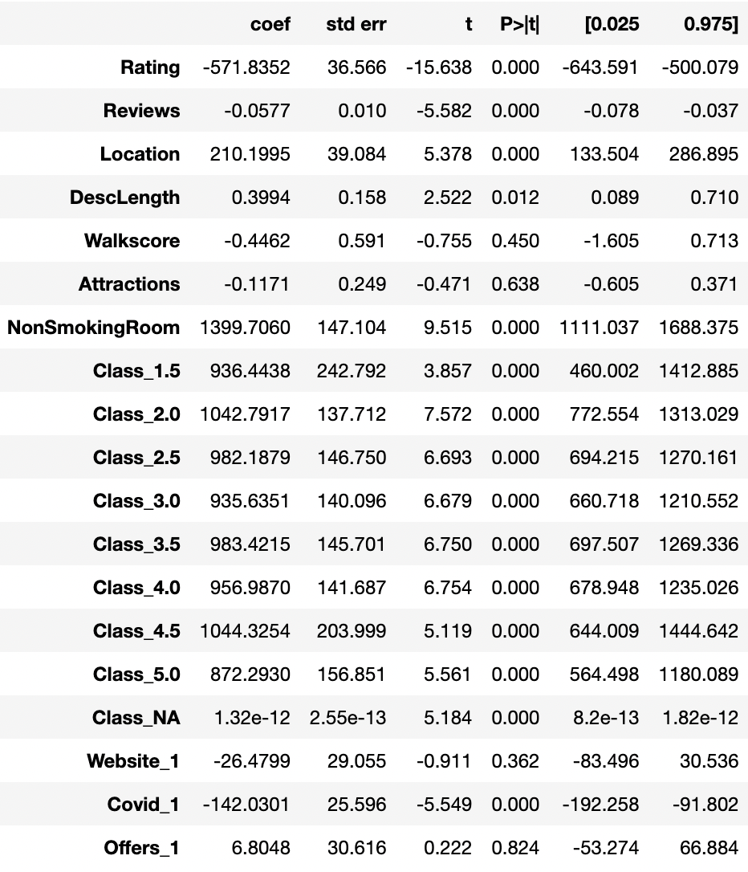
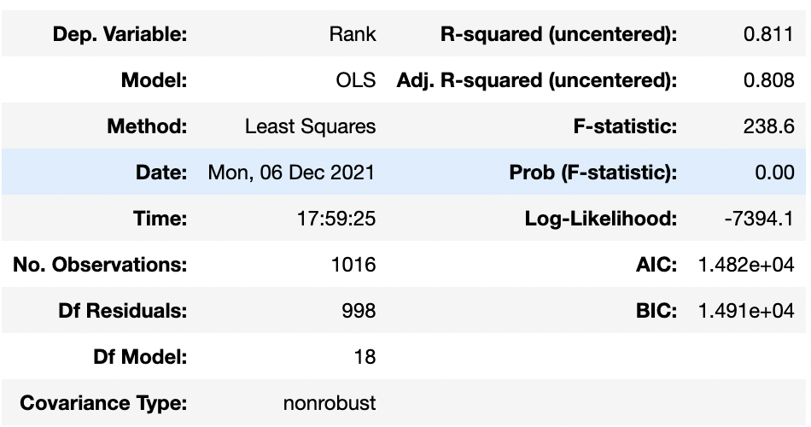
Linear Regression Results

Slide 26
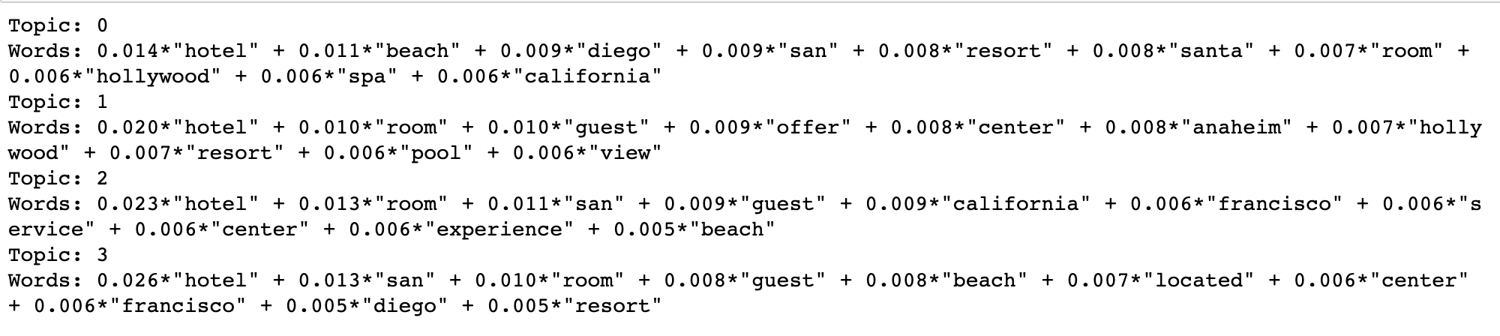
Topic Modeling Results

